Slide 1


Nepřímá řeč 1 - cvičení
Číslo projektu: | CZ.1.07/1.5.00/34.0465
Vzdělávací celek: | Jazykové vzdělávání a komunikace
Tematický okruh: | Gramatika
Téma: | Nepřímá řeč 1 – cvičení (indirect speech)
Ročník: | čtvrtý
Jméno autora: | Mgr. Petra Klimešová
Vytvořeno dne: | 8. 8. 2012
Anotace | Materiál slouží k procvičení nepřímé řeči s přítomným a minulým časem prostým a průběhovým. Prvním úkolem žáků je přímou řeč převést do nepřímé a ve druhém cvičení nepřímou řeč převést na přímou. Materiál obsahuje i řešení úloh, ve kterém je uvedeno pouze jedno správné řešení, přestože někdy má úloha více správných řešení.
Metodický pokyn

Slide 2


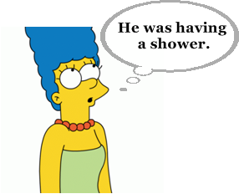
Write the sentences in indirect speech:
1a. Lisa said that
Bart wasn‘t going
to school.
2a. Marge said that ………………………………
………………………………

Slide 3
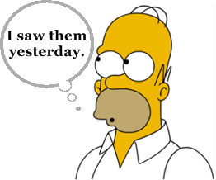
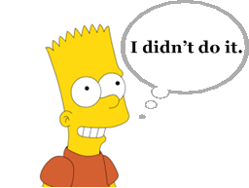
3a. Homer told me that
………………………………
………………………………
4a. Bart said that ………………………………
………………………………

Slide 4
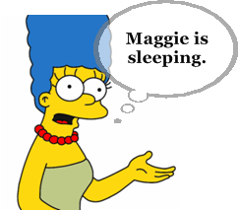
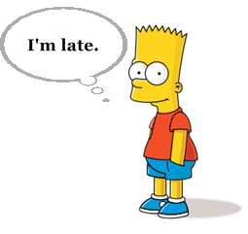
5a. Marge said that ………………………………
………………………………
6a. Bart admitted that
………………………………
………………………………

Slide 5

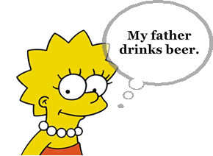
7a. Flanders replied that ………………………………
………………………………
8a. Lisa said that ………………………………
………………………………

Slide 6
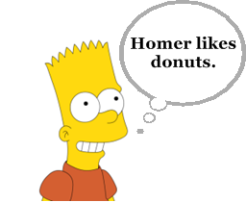

9a. Bart said that ………………………………
………………………………
10a. Homer thought that
………………………………
………………………………

Slide 7
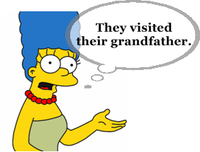
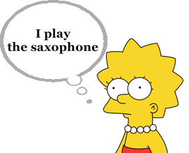
11a. Marge said that ………………………………
………………………………
12a. Lisa admitted that
………………………………
………………………………

Slide 8

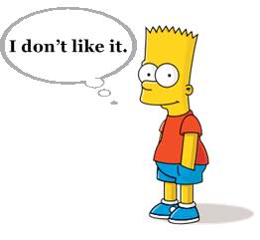
13a. Lisa said that ………………………………
………………………………
14a. Bart admitted that
………………………………
………………………………

Slide 9
Rewrite the sentences into direct speech:
1b. Bart said that he was going out.
„I am going out.“
2b. Marge said that she cooked in the evenings.
…………………………………………………………………………
3b. Homer admitted that he drank too much.
…………………………………………………………………………
4b. Lisa said that she had been at school.
…………………………………………………………………………

Slide 10
5b. Lisa told me that she had been playing the saxophone the day before.
…………………………………………………………………………
6b. Marge said that she was washing up.
…………………………………………………………………………
7b. Lisa admitted that she liked studying.
…………………………………………………………………………
8b. Homer said that he hadn‘t been watching TV.
…………………………………………………………………………

Slide 11

Řešení:
1a. Lisa said that
Bart wasn‘t going
to school.
2a. Marge said that he had been having
a shower.

Slide 12
3a. Homer told me that
he had seen them
the day before.
4a. Bart said that he hadn‘t done it.

Slide 13
5a. Marge said that Maggie was sleeping.
6a. Bart admitted that
he was late.

Slide 14
7a. Flanders replied that they were having
lunch.
8a. Lisa said that her father drank beer.

Slide 15
9a. Bart said that Homer liked donuts.
10a. Homer thought that
weren‘t there.

Slide 16
11a. Marge said that they had visited
their grandfather.
12a. Lisa admitted that
she played
the saxophone.

Slide 17
13a. Lisa said that they were
watching TV.
14a. Bart admitted that
he didn‘t like it.

Slide 18
1b. Bart said that he was going out.
„I am going out.“
2b. Marge said that she cooked in the evenings.
„I cook in the evenings.“
3b. Homer admitted that he drank too much.
„I drink too much.“
4b. Lisa said that she had been at school.
„I was at school.“

Slide 19
5b. Lisa told me that she had been playing the saxophone the day before.
„I was playing the saxophone yesterday.“
6b. Marge said that she was washing up.
„I am washing up.“
7b. Lisa admitted that she liked studying.
„I like studying.“
8b. Homer said that he hadn‘t been watching TV.
„I wasn‘t watching TV.“

Slide 20
Použité zdroje
Pokud není uvedeno jinak, použitý materiál je z vlastních zdrojů autora
https://www.google.cz/search?q=otazn%C3%ADk&hl=cs&client=firefox-a&hs=r7r&rls=org.mozilla:cs:official&prmd=imvns&tbm=isch&tbo=u&source=univ&sa=X&ei=PrgiUM7NBouRswbXloDgBg&ved=0CFwQsAQ&biw=1366&bih=624
https://www.google.cz/search?q=%C5%BD%C3%81ROVKA&hl=cs&client=firefox-a&hs=t1r&sa=X&rls=org.mozilla:cs:official&prmd=imvns&tbm=isch&tbo=u&source=univ&ei=zLYiUN2SM8nntQaZ3YCACg&ved=0CGgQsAQ&biw=1366&bih=624
https://www.google.cz/search?q=lisa&hl=cs&client=firefox-a&hs=sKo&rls=org.mozilla:cs:official&prmd=imvnsl&tbm=isch&tbo=u&source=univ&sa=X&ei=RiImUPyqE5HusgbgzYCIBQ&ved=0CGkQsAQ&biw=1150&bih=600 (obr. 1a, 8a, 12a, 13a)
https://www.google.cz/search?q=marge&hl=cs&client=firefox-a&hs=Qy8&rls=org.mozilla:cs:official&prmd=imvns&tbm=isch&tbo=u&source=univ&sa=X&ei=2SEmUO5vx86yBu6lgaAL&ved=0CF0QsAQ&biw=1150&bih=600 (obr. 2a, 5a, 11a)
https://www.google.cz/search?q=homer&hl=cs&client=firefox-a&hs=w2Z&rls=org.mozilla:cs:official&prmd=imvnsb&tbm=isch&tbo=u&source=univ&sa=X&ei=BoImUKSiNObm4QSphoHYBA&ved=0CF0QsAQ&biw=1150&bih=600 (obr. 3a, 10a)
https://www.google.cz/search?q=bart&hl=cs&client=firefox-a&hs=508&rls=org.mozilla:cs:official&prmd=imvns&tbm=isch&tbo=u&source=univ&sa=X&ei=fiImULuSNMnvsgbPq4CoBQ&ved=0CGgQsAQ&biw=1150&bih=600 (obr. 4a, 6a, 9a, 14a)
https://www.google.cz/search?q=flanders&hl=cs&client=firefox-a&hs=N7Z&rls=org.mozilla:cs:official&prmd=imvns&tbm=isch&tbo=u&source=univ&sa=X&ei=GYMmUK7jBs774QTr0YGoCA&ved=0CG8QsAQ&biw=1150&bih=600 (obr. 7a)

