Slide 1


Nepřímá řeč 2 - cvičení
Číslo projektu: | CZ.1.07/1.5.00/34.0465
Vzdělávací celek: | Jazykové vzdělávání a komunikace
Tematický okruh: | Gramatika
Téma: | Nepřímá řeč 2 – cvičení (indirect speech)
Ročník: | čtvrtý
Jméno autora: | Mgr. Petra Klimešová
Vytvořeno dne: | 8. 8. 2012
Anotace | Materiál slouží k procvičení nepřímé řeči s předpřítomným a předm inulým časem a budoucími časy will a going to. Prvním úkolem žáků je přímou řeč převést do nepřímé a ve druhém cvičení nepřímou řeč převést na přímou. Materiál obsahuje i řešení úloh, ve kterém je uvedeno pouze jedno správné řešení, přestože někdy má úloha více správných řešení.
Metodický pokyn

Slide 2

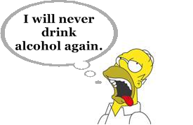
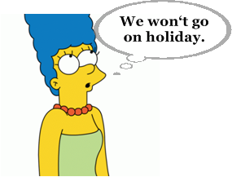
Write the sentences in indirect speech:
1a. Homer promised
that he would never
drink again.
2a. Marge said that ………………………………
………………………………

Slide 3
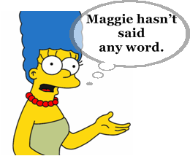
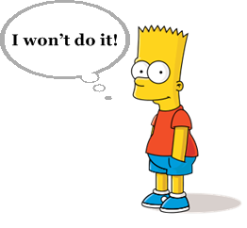
3a. Marge told Homer that ………………………
………………………………
4a. Bart said that
………………………………
………………………………

Slide 4
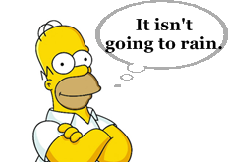
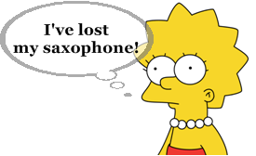
5a. Homer said that ………………………………
………………………………
6a. Lisa admitted that
………………………………
………………………………

Slide 5

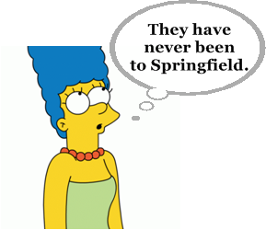
7a. Lisa told us that
………………………………
………………………………
8a. Marge said that ………………………………
………………………………

Slide 6
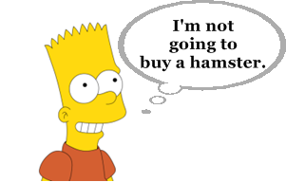
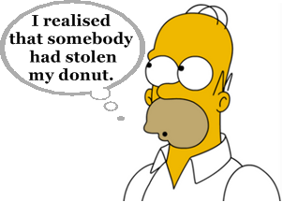
9a. Bart said that ………………………………
………………………………
10a. Homer said that
………………………………
………………………………

Slide 7
Rewrite the sentences into direct speech:
1b. Marge said that she had never seen it.
„I have never seen it.“
2b. Lisa said that Maggie was playing in the garden.
…………………………………………………………………
3b. Homer said that he went to the pub every Friday.
…………………………………………………………………

Slide 8
4b. Marge told Homer that she had realised that Bart had cheated.
…………………………………………………………………
5b. Lisa said that she had found a dog.
…………………………………………………………………
6b. Bart said that he had broken his bike.
…………………………………………………………………

Slide 9

Řešení:
1. Homer promised that
he would never drink
again.
2. Marge said that they wouldn‘t go
on holiday.

Slide 10
3a. Marge told Homer that Maggie hadn‘t
said any word.
4a. Bart said that
he wouldn‘t do it.

Slide 11
5a. Homer said that it wasn‘t going
to rain.
6a. Lisa admitted that
she had lost
her saxophone.

Slide 12
7a. Lisa told us that
they were going to
visit them.
8a. Marge said that they had never been
to Springfield.

Slide 13
9a. Bart said that he wasn‘t going to
buy a hamster.
10a. Homer said that
he had realised that
somebody had stolen
his donut.

Slide 14
1b. Marge said that she had never seen it.
„I have never seen it.“
2b. Lisa said that Maggie was playing in the garden.
„Maggie is playing in the garden.“
3b. Homer said that he went to the pub every Friday.
„I go to the pub every Friday.“

Slide 15
4b. Marge told Homer that she had realised that Bart had cheated.
„I realised that Bart had cheated.“
5b. Lisa said that she had found a dog.
„I found a dog.“
6b. Bart said that he had broken his bike.
„I broke my bike.“

Slide 16
Použité zdroje
Pokud není uvedeno jinak, použitý materiál je z vlastních zdrojů autora
https://www.google.cz/search?q=otazn%C3%ADk&hl=cs&client=firefox-a&hs=r7r&rls=org.mozilla:cs:official&prmd=imvns&tbm=isch&tbo=u&source=univ&sa=X&ei=PrgiUM7NBouRswbXloDgBg&ved=0CFwQsAQ&biw=1366&bih=624
https://www.google.cz/search?q=%C5%BD%C3%81ROVKA&hl=cs&client=firefox-a&hs=t1r&sa=X&rls=org.mozilla:cs:official&prmd=imvns&tbm=isch&tbo=u&source=univ&ei=zLYiUN2SM8nntQaZ3YCACg&ved=0CGgQsAQ&biw=1366&bih=624
https://www.google.cz/search?q=homer&hl=cs&client=firefox-a&hs=w2Z&rls=org.mozilla:cs:official&prmd=imvnsb&tbm=isch&tbo=u&source=univ&sa=X&ei=BoImUKSiNObm4QSphoHYBA&ved=0CF0QsAQ&biw=1150&bih=600 (obr. 1a, 5a, 10a)
https://www.google.cz/search?q=marge&hl=cs&client=firefox-a&hs=Qy8&rls=org.mozilla:cs:official&prmd=imvns&tbm=isch&tbo=u&source=univ&sa=X&ei=2SEmUO5vx86yBu6lgaAL&ved=0CF0QsAQ&biw=1150&bih=600 (obr. 2a, 3a, 8a)
https://www.google.cz/search?q=bart&hl=cs&client=firefox-a&hs=508&rls=org.mozilla:cs:official&prmd=imvns&tbm=isch&tbo=u&source=univ&sa=X&ei=fiImULuSNMnvsgbPq4CoBQ&ved=0CGgQsAQ&biw=1150&bih=600 (obr. 4a, 9a)
https://www.google.cz/search?q=lisa&hl=cs&client=firefox-a&hs=sKo&rls=org.mozilla:cs:official&prmd=imvnsl&tbm=isch&tbo=u&source=univ&sa=X&ei=RiImUPyqE5HusgbgzYCIBQ&ved=0CGkQsAQ&biw=1150&bih=600 (obr. 6a, 7a)

